Slide 1

Triggers and Transactions
Database Programmability
SoftUni Team
Technical Trainers
Software University
https://about.softuni.bg/

Slide 2
Table of Contents
Transactions
ACID Model
Triggers
Database Security
2

Slide 3
Questions
sli.do #csharp-db

Slide 4
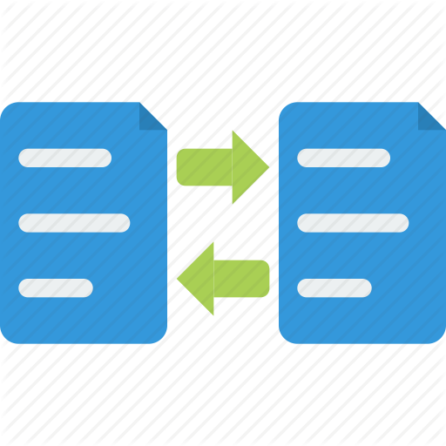
Transactions
Definition, Usage, ACID Model

Slide 5
Transactions
A Transaction is a sequence of actions (database operations) executed as a whole:
Either all of them complete successfully or none of them do
Examples:
A bank transfer from one account into another (withdrawal + deposit)
If either the withdrawal or the deposit fails the whole operation is cancelled

Slide 6

Transactions: Lifecycle (Rollback)
Read
Write
Durable starting state
Sequence of reads and writes
Durable,
consistent,
ending state
Write
Rollback

Slide 7

Transactions: Lifecycle (Commit)
Read
Write
Durable starting state
Sequence of reads and writes
Durable,
consistent,
ending state
Write
Commit

Slide 8
Transactions Behavior
Transactions guarantee the consistency and the integrity of the database
All changes in a transaction are temporary
Changes are persisted when a COMMIT is executed
At any time, all changes can be canceled by ROLLBACK
All changes are persisted at once
As long as COMMIT is called

Slide 9
Transactions: What Can Go Wrong?
Some actions fail to complete
The application software or database server crashes
The user cancels the action while it’s in progress
Interference from another transaction
What happens if several transfers run for the same account at the same time?
Notes:
Use transfer example, not cash machine for failing to complete

Slide 10


Checkpoints in Games
DIE
Castle 1-2
Castle 1-3
Mario
SURVIVE

Slide 11


What Are Transactions?
ROLLBACK
STATE 1
STATE 2
COMMIT
Queries
Notes:
Transaction is a sequence of actions (database operations) executed as a whole:
Either all of them complete successfully
Or none of the them
Example of transaction:
A bank transfer from one account into another (withdrawal + deposit)
If either the withdrawal or the deposit fails the whole operation is cancelled

Slide 12
Transactions Syntax
CREATE PROC usp_Withdraw (@withdrawAmount DECIMAL(18,2), @accountId INT)
AS
BEGIN TRANSACTION
UPDATE Accounts SET Balance = Balance - @withdrawAmount
WHERE Id = @accountId
IF @@ROWCOUNT <> 1 -- Didn’t affect exactly one row
BEGIN
ROLLBACK
THROW 50001, 'Invalid account!’, 1
RETURN
END
COMMIT
Start Transaction
Withdraw Money
Undo Changes
Save Changes
Notes:
Start a transaction
BEGIN TRANSACTION
Some RDBMS use implicit start, e.g. Oracle
Ending a transaction
COMMIT
Complete a successful transaction and persist all changes made
ROLLBACK
“Undo” changes from an aborted transaction
May be done automatically when failure occurs

Slide 13
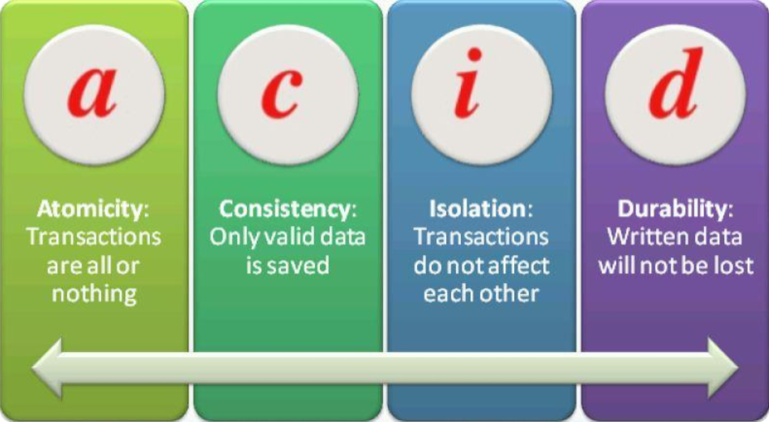
ACID Models
Solving Problems Before They Arise

Slide 14


Transaction Properties
Modern DBMS servers have built-in transaction support
Implement "ACID" transactions
MS SQL Server, Oracle, MySQL, PostgreSQL, etc.
ACID means:
Atomicity
Consistency
Isolation
Durability

Slide 15
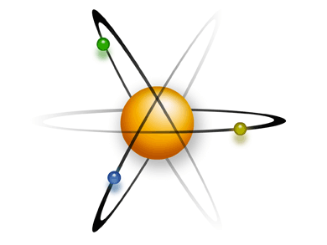
Atomicity
Atomicity means that:
Transactions execute as a whole
DBMS guarantees that either all of the operations are performed or none of them
Example: Transferring funds between bank accounts
Either withdraw + deposit both succeed, or none of them do
In case of failure, the database stays unchanged

Slide 16
Consistency
Consistency means that:
The database has a legal state in both the transaction’s beginning and its end
Only valid data will be written to the DB
Transaction cannot break the rules of the database
Primary keys, foreign keys, check constraints, data types…
Consistency example:
Transaction cannot end with a duplicate primary key in a table

Slide 17
Isolation
Isolation means that:
Multiple transactions running at the same time do not impact each other's execution
Transactions don’t see other transactions’ uncommitted changes
Isolation level defines how deep transactions isolate from one another
Isolation example:
If two or more people try to buy the last copy of a product, only one of them will succeed

Slide 18

Durability
Durability means that:
If a transaction is committed it becomes persistent
Cannot be lost or undone
Ensured by the use of database transaction logs
Durability example:
After funds are transferred and committed, the power supply at the DB server is lost
Transaction stays persistent (no data is lost)

Slide 19
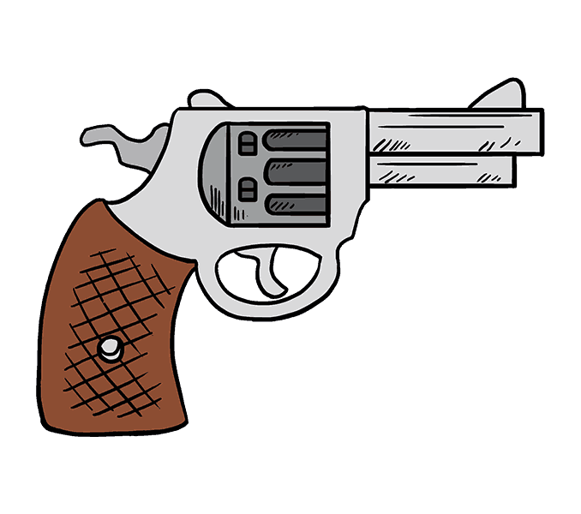
Triggers

Slide 20
What Are Triggers?
Triggers are very much like stored procedures
Called in case of a specific event
We do not call triggers explicitly
Triggers are attached to a table
Triggers are fired when a certain SQL statement is executed against the contents of the table
Syntax:
AFTER INSERT/UPDATE/DELETE
INSTEAD OF INSERT/UPDATE/DELETE

Slide 21
After Trigger
AFTER Trigger is executed right after an event is fired
Query
Trigger
Event

Slide 22
Instead of Trigger
INSTEAD OF Trigger completely replaces an event action from happening
You can apply totally different logic
Trigger
Query

Slide 23
Events
There are three different events that can be applied within a trigger:
Events
Insert
Update
Delete

Slide 24
After Triggers
Defined by the keyword FOR
CREATE TRIGGER tr_AddToLogsOnAccountUpdate
ON Accounts FOR UPDATE
AS
INSERT INTO Logs(AccountId, OldAmount, NewAmount, UpdatedOn)
SELECT i.Id, d.Balance, i.Balance, GETDATE()
FROM inserted AS i
JOIN deleted AS d ON i.Id = d.Id
WHERE i.Balance != d.Balance
GO

Slide 25
Instead of Triggers
Defined by using INSTEAD OF
CREATE OR ALTER TRIGGER tr_SetIsDeletedOnDelete
ON AccountHolders
INSTEAD OF DELETE
AS
UPDATE AccountHolders SET IsDeleted = 1
WHERE Id IN (SELECT Id FROM deleted)
GO

Slide 26
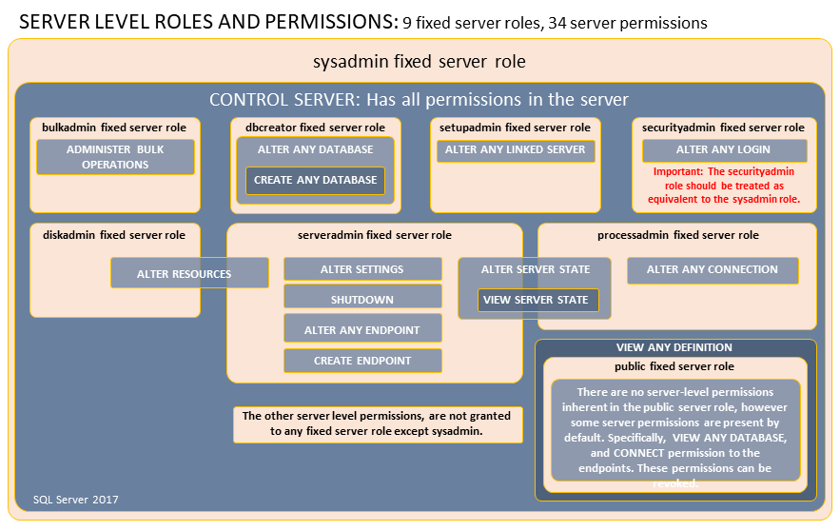

Database Security
Fixed Server Roles, Fixed Database Roles

Slide 27
Database Security: SQL Server
SQL Server has two layers of database security:
Fixed Server Roles
sysadmin, bulkadmin, dbcreator, securityadmin
Fixed Database Roles
db_owner, db_securityadmin, db_accessadmin
db_backupoperator, db_ddladmin
db_datareader/db_datawriter

Slide 28


Custom Roles
SQL Server lets us create custom roles
Collection of privileges (permissions)
Fine control over permissions
Can use one role for multiple users (groups)
Makes auditing operations easier

Slide 29
Custom Role Permissions (1)
CONTROL SERVER/DATABASE
Gives all permissions on the server/database
TAKE OWNERSHIP
Enables the grantee to take ownership of a securable
VIEW CHANGE TRACKING
Manage change tracking on schemas and tables
VIEW DEFINITION
Enables the grantee to access metadata
EXECUTE
To run procedures, scalar and aggregate functions

Slide 30
Custom Role Permissions (2)
ALTER
Lets a role create, alter, and drop objects from the schema
REFERENCES
Lets the role create FOREIGN KEY constraints
SELECT/DELETE/INSERT/UPDATE
Grant access to CRUD Operations
Can be granted on database, schema and object level
Individual tables, views and columns can be targeted

Slide 31

Summary
…
…
…
Transactions give our operations stability
Operation Integrity
Solving the concurrent operation problem
The ACID model is implemented in most RDBMS
Triggers apply a given behavior when a condition is hit
Gives us temporary INSERTED and DELETED tables
Security in SQL Server can be finely controlled
Using fixed server roles and fixed database roles
Custom roles control permissions even more finely

Slide 32
Questions?
Notes:
32

Slide 33












SoftUni Diamond Partners

Slide 34


Educational Partners

Slide 35
Trainings @ Software University (SoftUni)
Software University – High-Quality Education, Profession and Job for Software Developers
softuni.bg, about.softuni.bg
Software University Foundation
softuni.foundation
Software University @ Facebook
facebook.com/SoftwareUniversity
Software University Forums
forum.softuni.bg
35
Notes:
35

Slide 36

License
This course (slides, examples, demos, exercises, homework, documents, videos and other assets) is copyrighted content
Unauthorized copy, reproduction or use is illegal
© SoftUni – https://about.softuni.bg
© Software University – https://softuni.bg
Notes:
36

